Slide 1
S2S testbed updates from ACMAD
Team:
SWIFT staff: Cheikh DIONE¹, Joshua TALIB², Elisabeth THOMSON³, Victor INDASI¹
Users: Pascal Moudi IGRI⁴, Ado Mpia BWAKA⁵
1) African Centre of Meteorological Applications for Development, Niamey, Niger
2) Centre for Ecology and Hydrology,
3) University of Reading, Reading, UK
4) Centre d’Application et de Prévision Climatologique de l’Afrique Centrale (CAPC-AC), Douala, Cameroon
5) World Health Organization – Inter-Country Support Team for West Africa, Ouagadougou, Burkina Faso

Slide 2
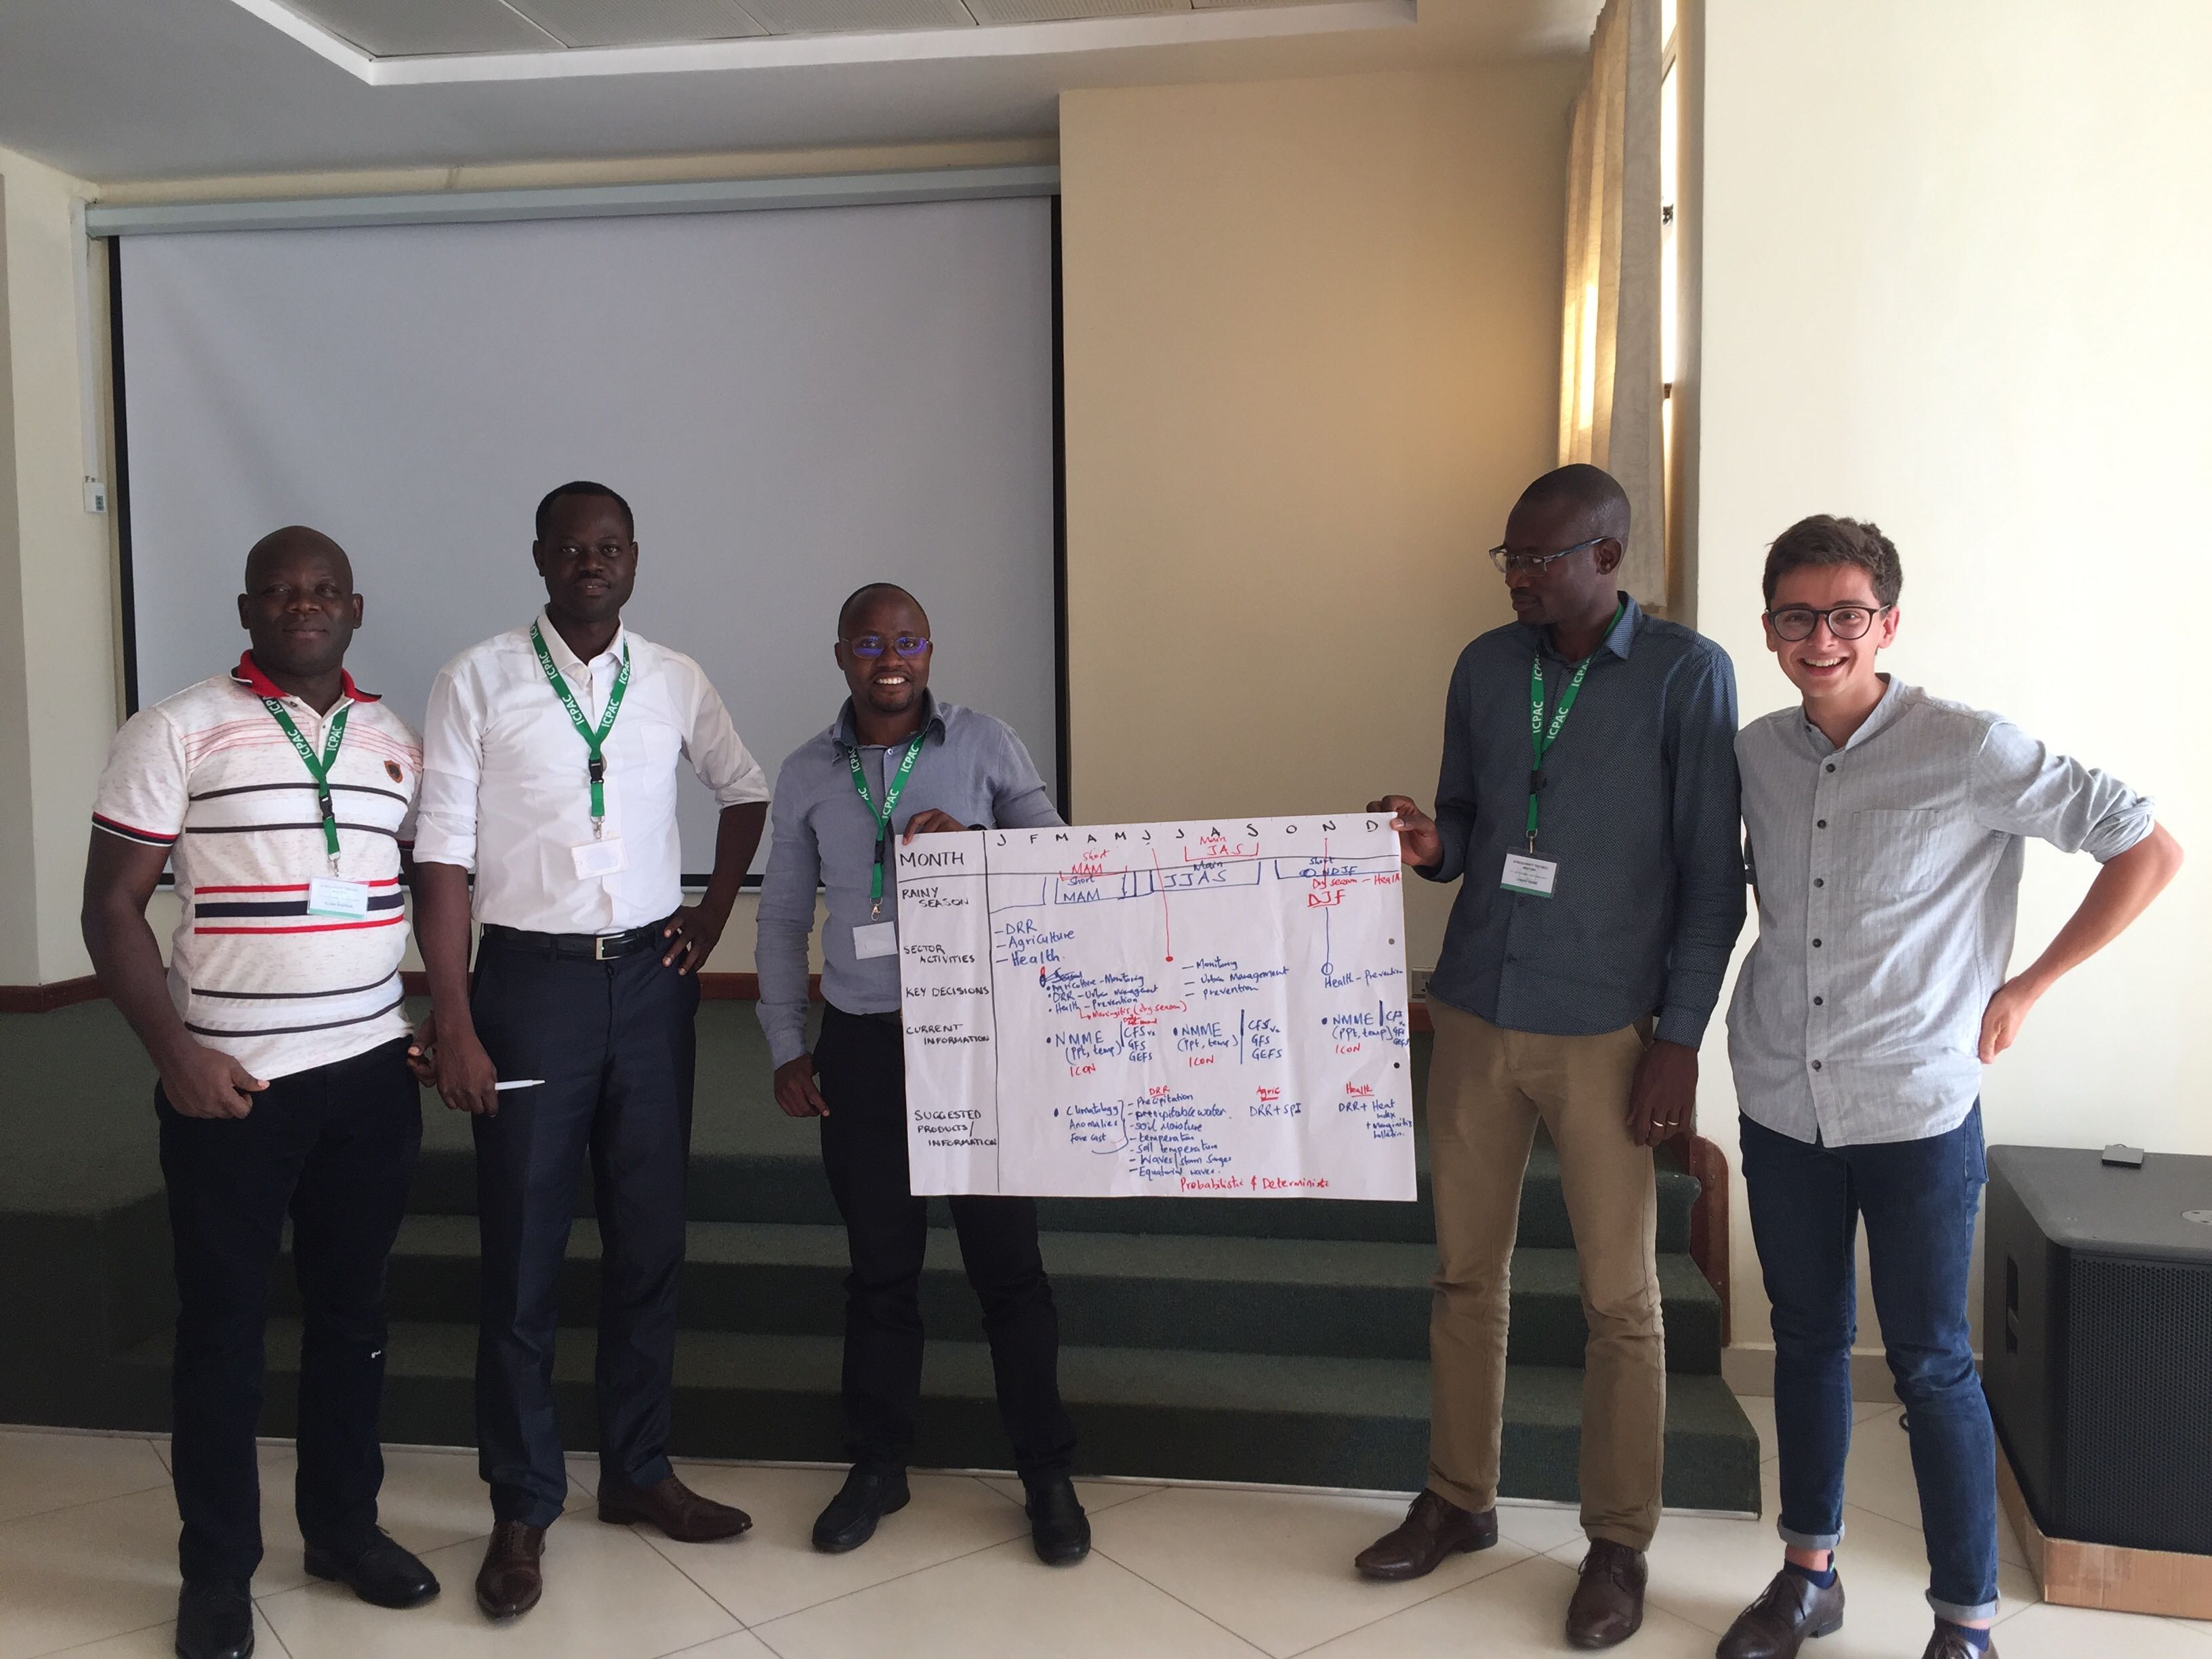
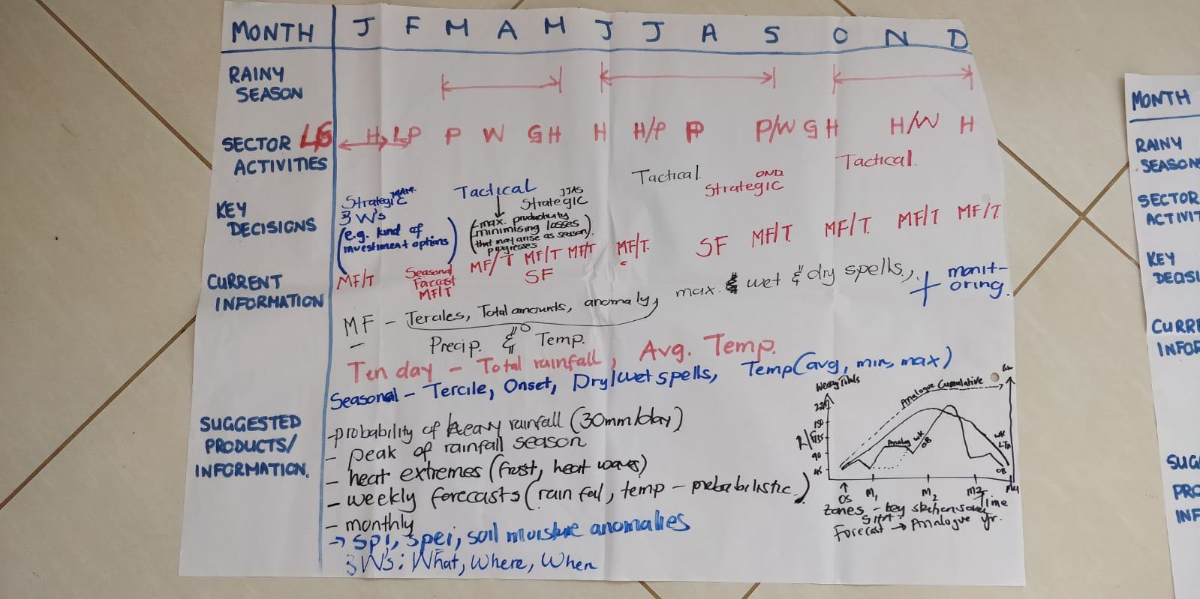
Co-production plan with CAPC-AC at Ngong
Testbed kickoff at Ngong in November 2019
Meteorological applications of S2S data
CAPC-AC key user of the s2s products: precipitation, wind, instability index, probability of extreme events, soil moisture etc.
Health sector
WHO key user of the weekly meningitis bulletin

Slide 3
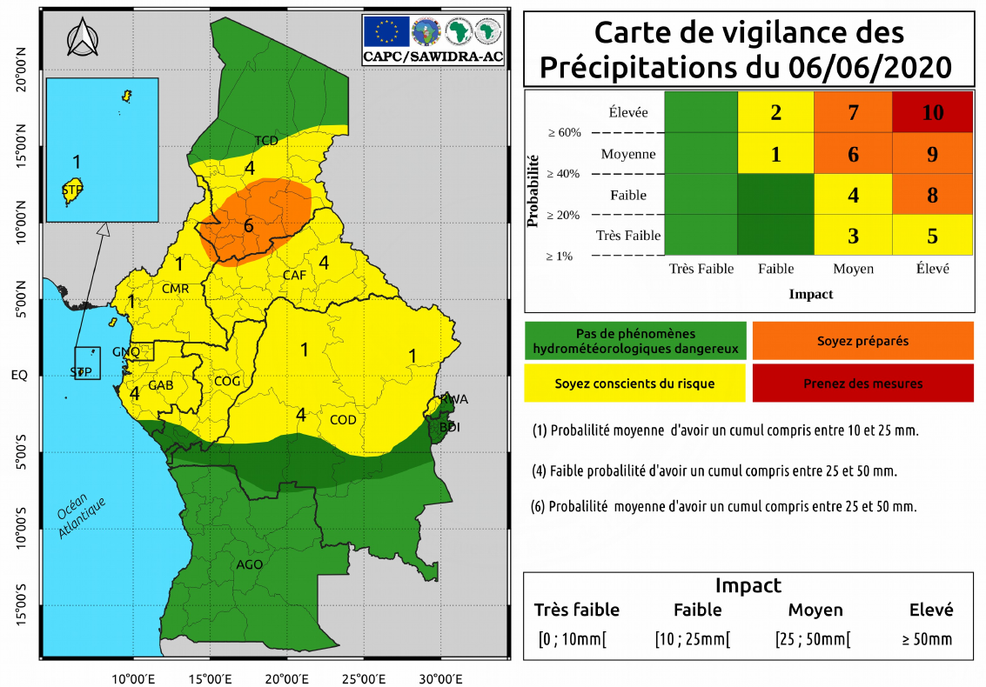
ACMAD Users: CAPC-AC
Dr Pascal Moudi IGRI, Numerical Weather Prediction Expert, Engeneer in Applied Meteorology
CAPC-AC Missions
Design , production and dissimination of weather and climate information and services to public and private sector and government in the ECCAS region
Training center on research and operationnal in atmospheric and environmental sciences, and climatology
Youngest RCC in Africa need support to acces to climate data and information

Slide 4
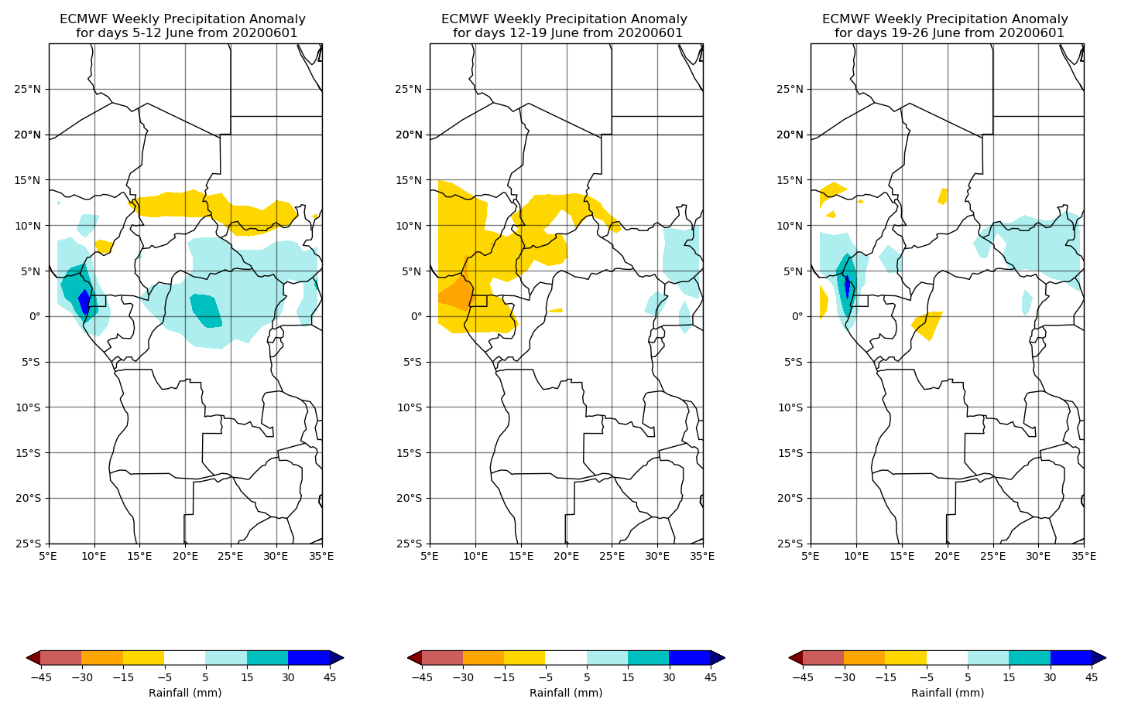
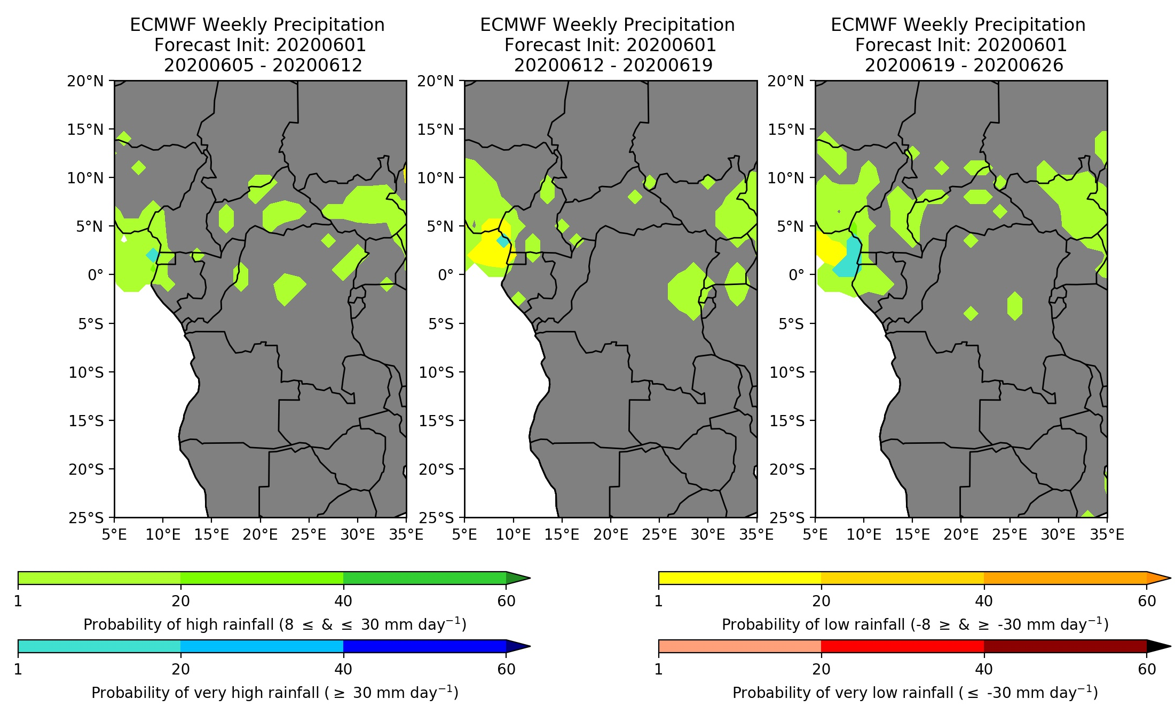
S2S products developed and dissimated to CAPC-AC
Weekly precipitation anomaly (week 1 to 3 )
Weekly probability of extreme events (week 1 to 3 )

Slide 5
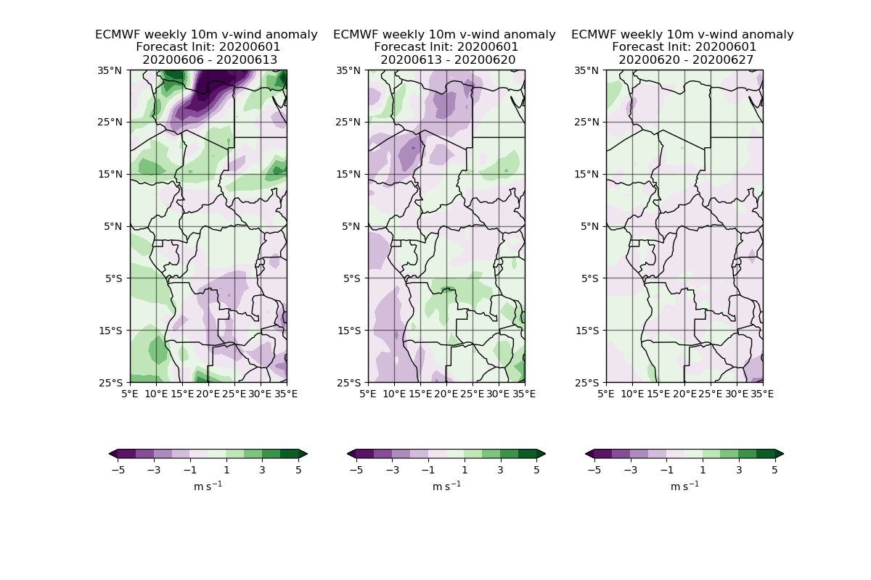
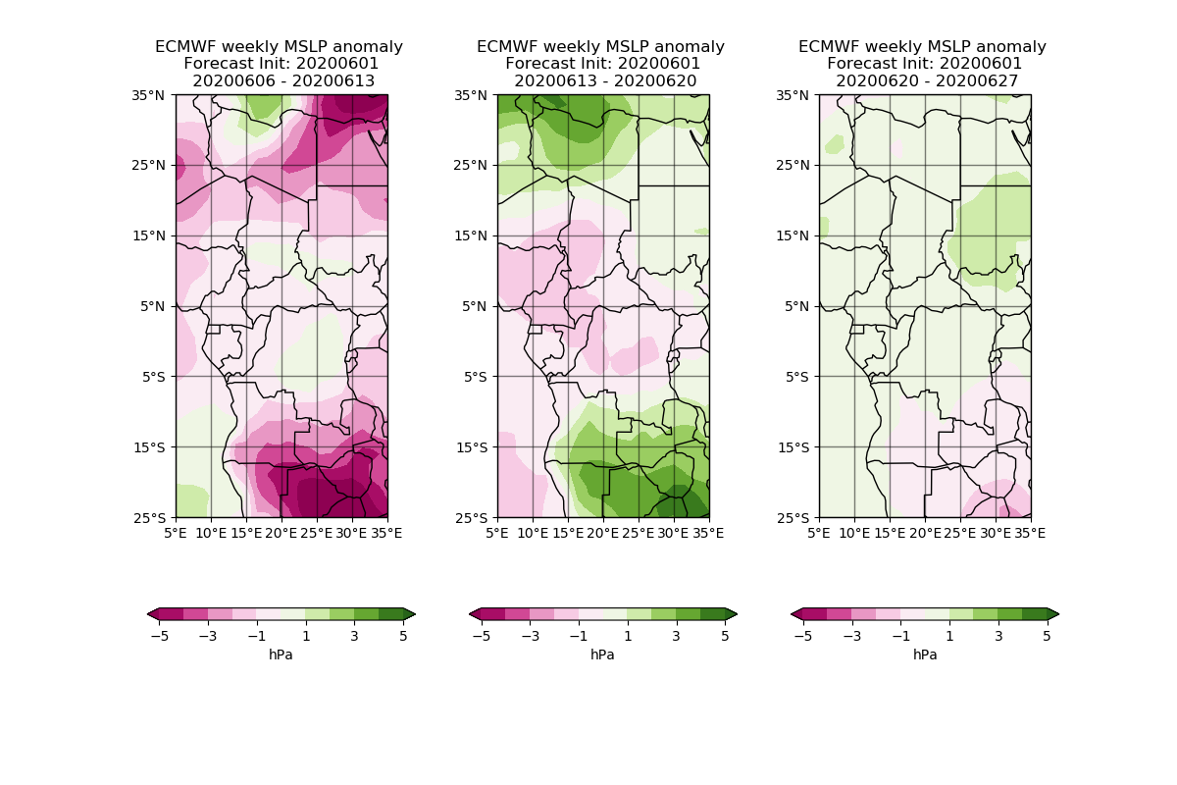
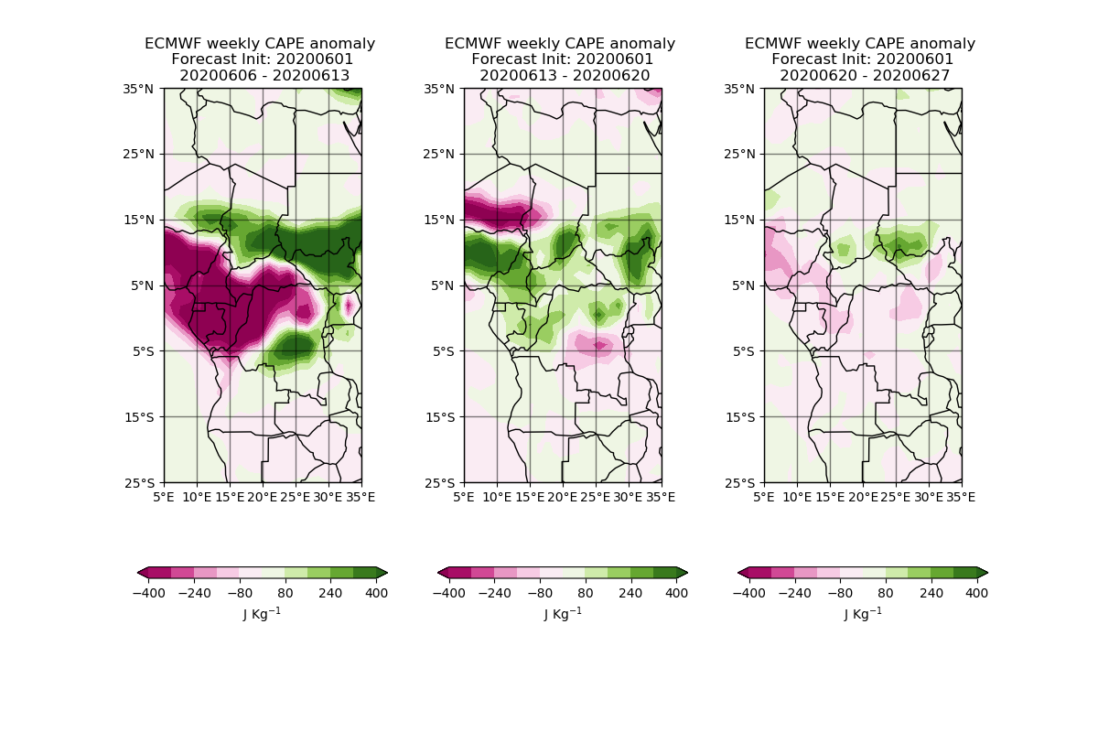
S2S products developed and dissimated to CAPC-AC
Weekly U10 anomaly (week 1 to 3 )
Weekly V10 anomaly (week 1 to 3 )
Weekly MSL anomaly (week 1 to 3 )
Weekly CAPE anomaly (week 1 to 3 )

Slide 6
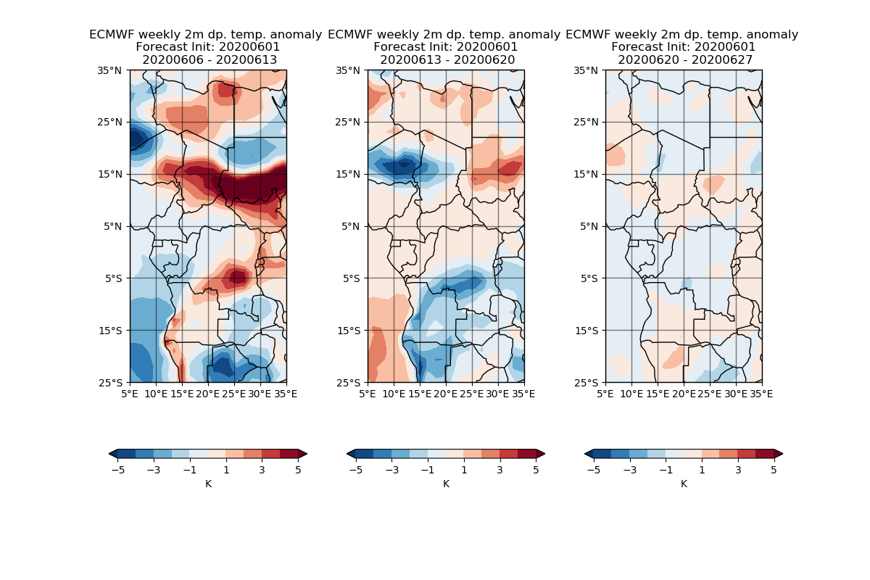
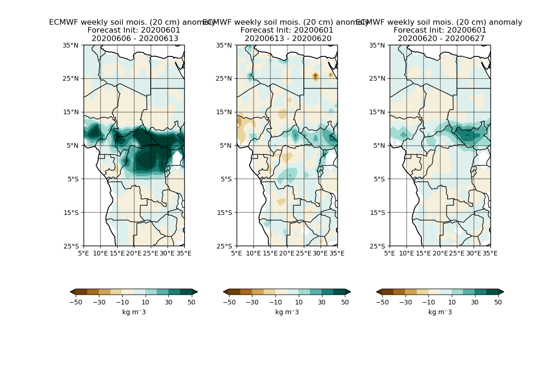
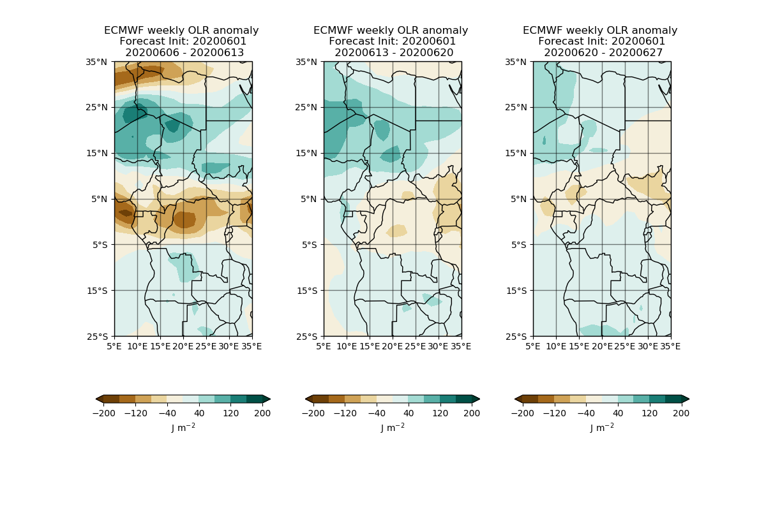
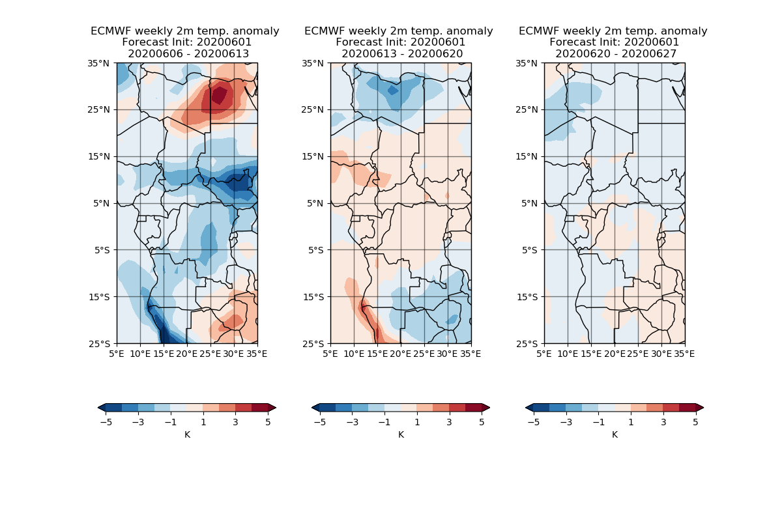
S2S products developed and dissimated to CAPC-AC
Weekly Soil moisture anomaly at 20 cm (week 1 to 3 )
Weekly dew point temperature anomaly at 2 m (week 1 to 3 )
Weekly OLR anomaly (week 1 to 3 )
Weekly temperature anomaly at 2 m (week 1 to 3 )

Slide 7
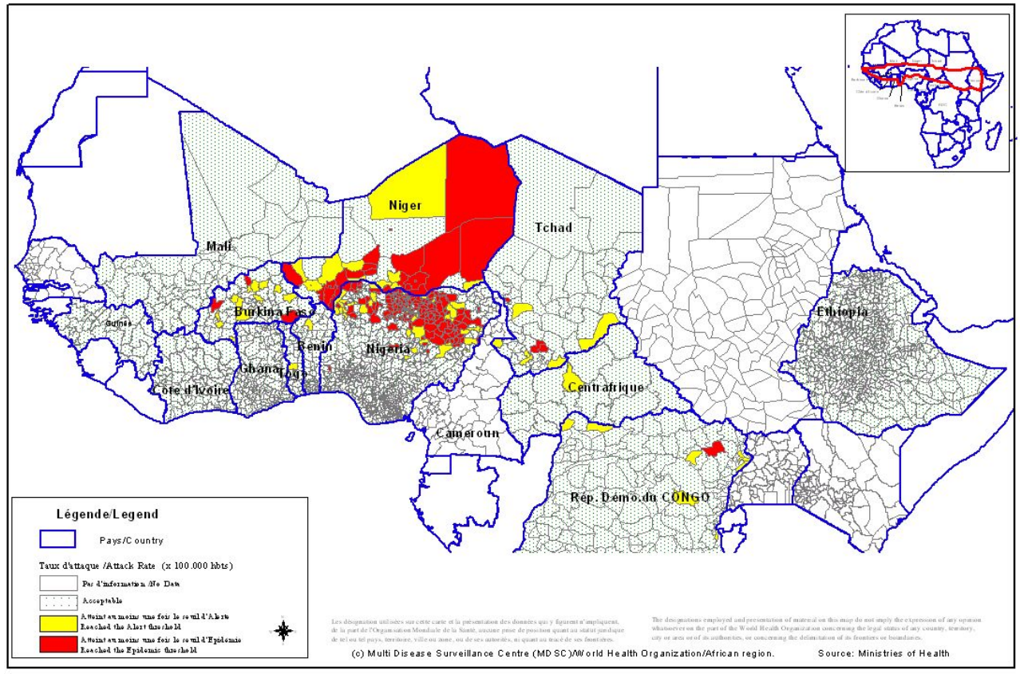
ACMAD Users: WHO
Dr Ado Bwaka – Vaccine Preventable Diseases/Polio Eradication Programme Team Leader, Inter-Country Support Team (IST) West Africa, World Health Organization (WHO)
Missions
Coordinating immunization by providing technical support to West African countries in planning, implementing and monitoring/evaluating
Supporting countries on Supplemental Immunization Activities, Vaccine and Preventable Disease Surveillance.
Alerting countries especially the 26 countries of the meningitis belt to prepare for meningitis epidemics and respond to them adequately
Providing technical assistance to countries affected by meningitis outbreaks during the dry season.
Week 1-19 & 2009
Reported meningitis cases during week 1 to 19 in 2009

Slide 8
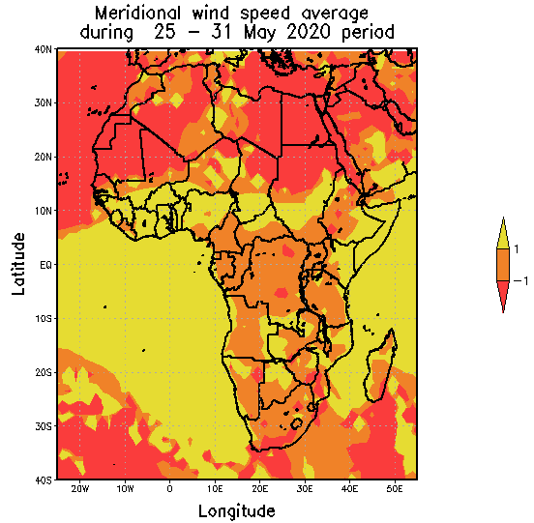
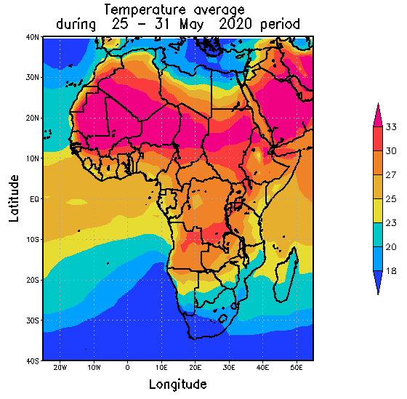
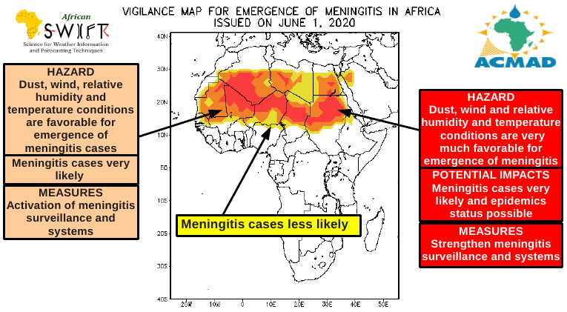
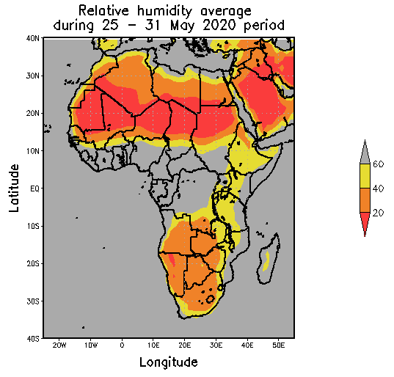
S2S data to support the weekly meningitis bulletin dissiminated to WHO
ECMWF fore cast
Since 12 February 2020, 18 bulletins shared by email to WHO
+ surface dust concentrations

Slide 9
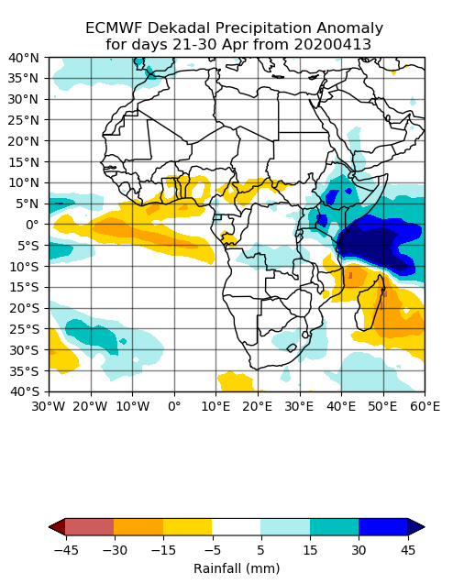
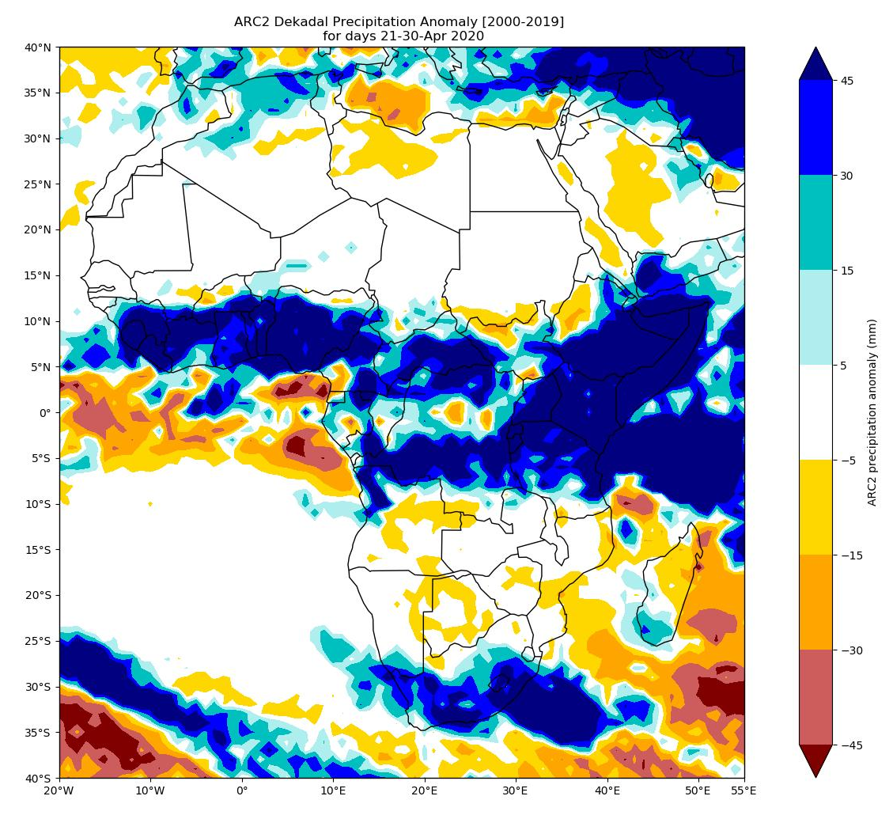
S2S Forecast evaluation to identify case study and drivers
ARC2 Dataset

Slide 10
S2S Forecast evaluation to identify case study and drivers
ARC2 Dataset
Pan African product supporting ACMAD bulletins
S2S forecast missed very wet conditions over Golf of Guinea and Central Africa.

Slide 11
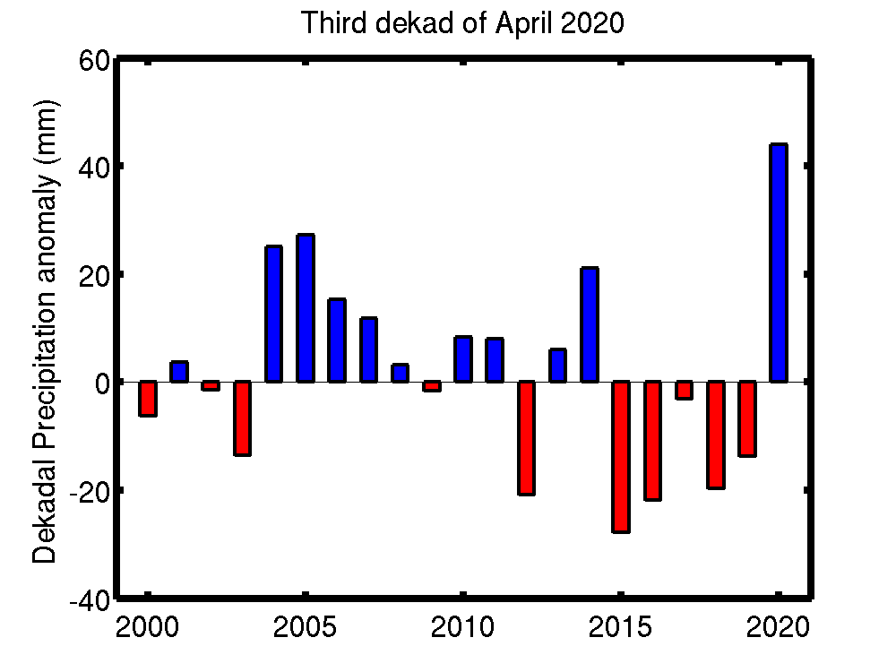
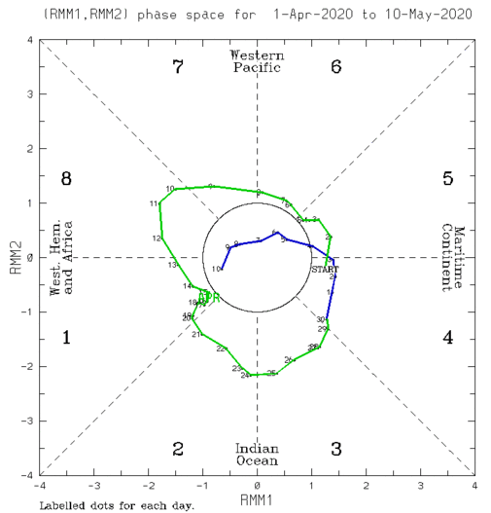
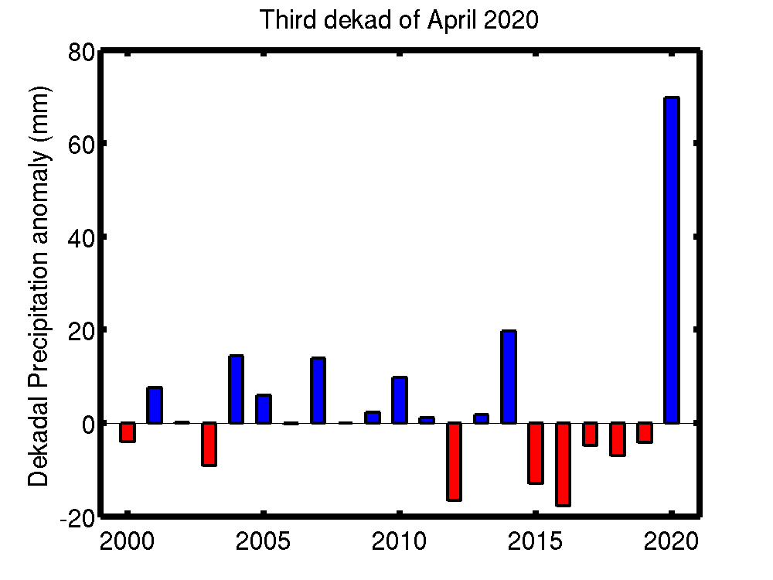
S2S Forecast evaluation to identify case study and drivers
Gulf of Guinea X[10W-10E] ; Y[2N-12N]
MJO
Kenya X[32E-45E] & Y[5S-5N]
26 April 2020 | Kenya | floods | 29 deaths | flooding in western and eastern counties, floodlist.com
Most wet third dekad of April since 2000
For more information on the RMM index and how to interpret its forecast please see:
https://www.cpc.ncep.noaa.gov/products/precip/CWlink/MJO/forca.shtml
- Phase 2: 21 - 24 April 2020
- Phase 3 : 26 - 30 April 2020

Slide 12
GCRF African SWIFT - Science for Weather Information and Forecasting Techniques
Future works
Identification of typical case study over Central Africa to be documented in co-production and West and East Africa in general
Analysis of the predictability (week 1 -4) of climate metrics favoring the meningitis outbreak
Develop news useful products to WHO (probability of heat waves), to CAPC-AC (IFS)
Documents on new operational products and operational best practice for the meningitis bulletin
Plan to Give during the WHO annual meeting October/november the status of the climate information for the coming dry season about the meningitis outbreak
This work was supported by UK Research and Innovation as part of the Global Challenges Research Fund, grant number NE/P021077/1.
https://africanswift.org/

