Slide 1
African SWIFT TESTBED 3: Planning…
(An update to WP1)
Victor INDASI (ACMAD)
Via Zoom on 24th June 2020

Slide 2
Background – Testbed 1B
Objective: - to create a working relationship for developmental testing of forecasting systems for Africa in a quasi-operational environment among researchers, operational meteorologists, and users.
Dates: - 23rd April to 6th May 2019 at KMD – Nairobi, Kenya
Two-day Users - workshop on “How to support users’ understanding and use of climate and weather services in Kenya” – on 30th April and 4th May 2019.
Users: - ForPAC project, Brookside Dairies, Ministry of Water Resources, Kenya Electricity Generating Company (KENGEN) and Kenya Broadcasting Cooperation (KBC)
Lesson (s): - User engagement was limited: the user workshop went well, but it was not integrated into the testbed.

Slide 3
Testbed 3
Objectives
To generate synthetic forecasts for up to 3 days + 1-day high impact weather forecasts for east and west Africa, aimed at specific users.
To generate nowcasting warnings for times 0-6 hours, aimed at specific users, using the synthetic forecasts and satellite-based nowcasting (NWC SAF).
To evaluate the forecasts and the nowcasts both in terms of accuracy and in terms of usefulness for specific users.

Slide 4
Dates & Plans:
Testbed 3 : - 6th to 20th September 2021
Co-production workshop : - 17th to 21st May 2021 – Enhance high integration of users
Management Team - representatives from SWIFT institutions & WMO. Meet every three months to discuss and approve overall decisions.
Pending decisions:
Location
Working groups e.g Nowcasting, synoptics, verification, IT, Cross-cutting etc
Users

Slide 5
Users and co-production Workgroup:
Designing the co-production workshop
Working with other groups to ensure the Testbed outputs are users – centred.
From National surveys –
Willingness to pay – Moderate.
Proposing – This be explored further in testbed 3

Slide 6
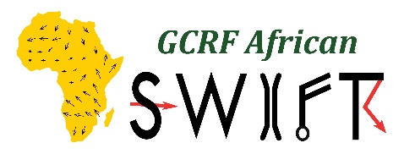
GCRF African SWIFT - Science for Weather Information and Forecasting Techniques
This work was supported by UK Research and Innovation as part of the Global Challenges Research Fund, grant number NE/P021077/1.

Slide 7
Asante
Thank you
Merci

