Slide 1
NATIONAL WCS - USER SURVEYS:
Preliminary Results.
GCRF African SWIFT - Science for Weather Information and Forecasting Techniques
Victor INDASI (ACMAD)
Via Zoom on 15th June 2020

Slide 2
Objective:
GCRF African SWIFT - Science for Weather Information and Forecasting Techniques
Explore & Understand WCS – User needs, communication network with NMHSs & explore areas of improvements both to WC products and communication.
Target Sectors:
Agriculture (& Fisheries)
Disaster Risk Management.
Energy.
Water.

Slide 3
Survey Schedule
GCRF African SWIFT - Science for Weather Information and Forecasting Techniques
Start: - November 2019
End: - February 2020
In cases where the surveys were manually administered the process on digitizing the responses began thereafter.
Data for all 4 partner countries has now been fully archived.
Data Analysis has been ongoing since March 2020, as country data became available.

Slide 4
GCRF African SWIFT - Science for Weather Information and Forecasting Techniques
Preliminary Results:
 | Ghana | Kenya | Nigeria | Senegal
Survey No. | 32 | 68 | 68 | 21
Sectors (A,D,E,W) | 24, 4, 4, 3 | 46, 8, 8, 6 | 27, 20, 15, 6 | 9, 5, 4, 3
Gender (M,F - %) | 90.1, 0.9 | 85.3, 14.7 | 77.9, 22.1 | 71.5, 28.5

Slide 5
Emerging themes:
GCRF African SWIFT - Science for Weather Information and Forecasting Techniques
Information Authority – NMHSs still the most preferred mode of accessing WCS.
Type of information – Sector sensitive
Preferred format – statistical summaries
Reliance on other web-based services - >60% of in the 4 countries.
Mainly due to ability to download data.
Explaining Forecast Accuracy – both Probabilities & short explanations.
Improved uptake of WCS -
Need for training
Interpretation of forecast (uncertainty)
Willingness to pay – Moderate

Slide 6
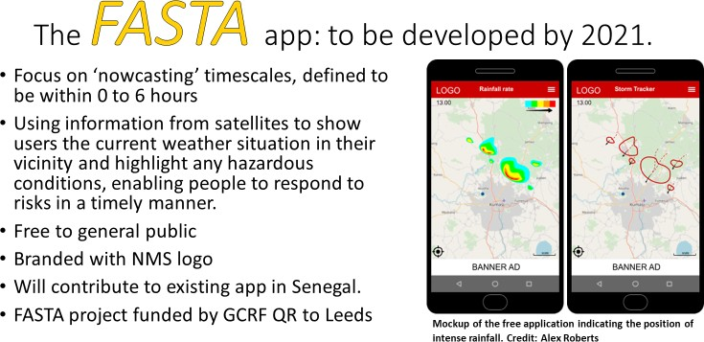
Willingness to pay:
GCRF African SWIFT - Science for Weather Information and Forecasting Techniques
Will be explored further in testbed 3 & Demonstration projects – Kenya & Ghana.

Slide 7
Special Thanks:
GCRF African SWIFT - Science for Weather Information and Forecasting Techniques
Country Survey Leads:
Gmet – Maureen.
KMD – Chris
NiMet – Ibrahim
ANACIM - Awa

Slide 8
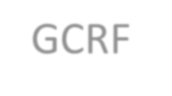
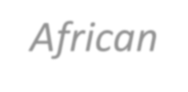
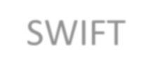
GCRF African SWIFT - Science for Weather Information and Forecasting Techniques
This work was supported by UK Research and Innovation as part of the Global Challenges Research Fund, grant number NE/P021077/1.

Slide 9
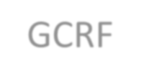
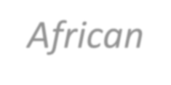
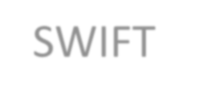
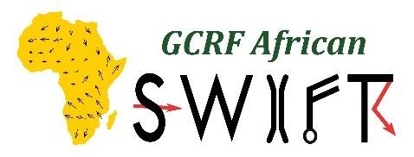
GCRF African SWIFT - Science for Weather Information and Forecasting Techniques
GCRF African SWIFT - Science for Weather Information and Forecasting Techniques
Asante Thank you Merci

